Slide 1
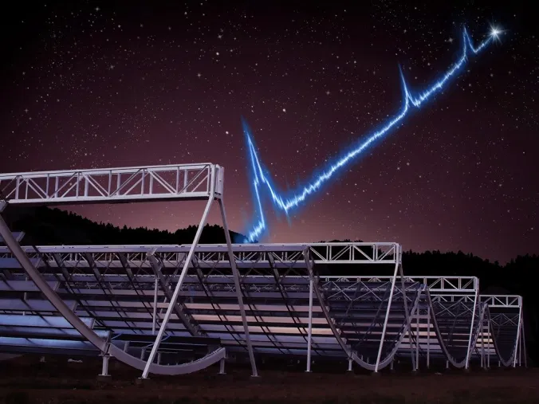
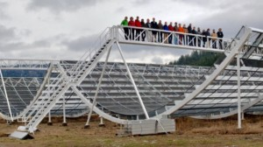
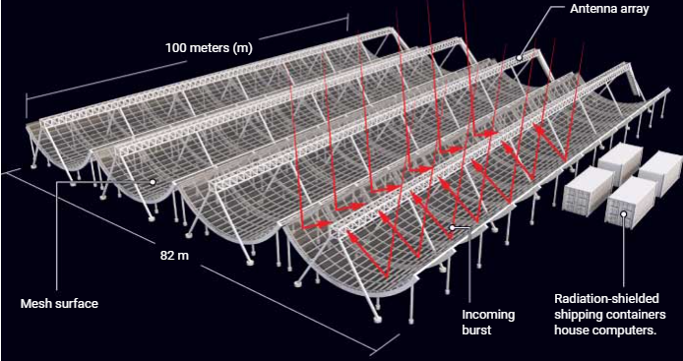
Canadian Hydrogen Mapping Experiment (CHIME)
Jacob Cardinal Tremblay, Julia Nilton, WVU
Abstract:
CHIME is a revolutionary new radio telescope used for Cosmology, Fast Radio Bursts (FRB) and Pulsar Astronomy. Here, we focus on the FRB/Pulsar side of the telescope, we will explain how the telescope works and why it’s unique design is revolutionary towards this field of astronomy.
Fig. 1: Telescope’s half-cylinders with people for scale. [McGill Reporter]
Fig. 2: An example of an incoming signal from a galactic source being detected by CHIME. [D. Futselaar]
Fig. 3: Diagram showing how CHIME receives and reflect signals into the antennas. [C. Bickel/Science]

Slide 2
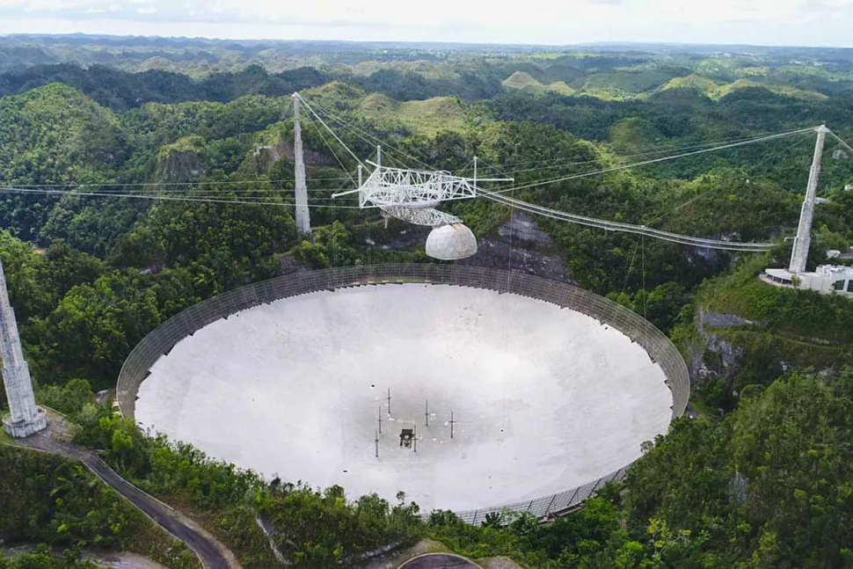
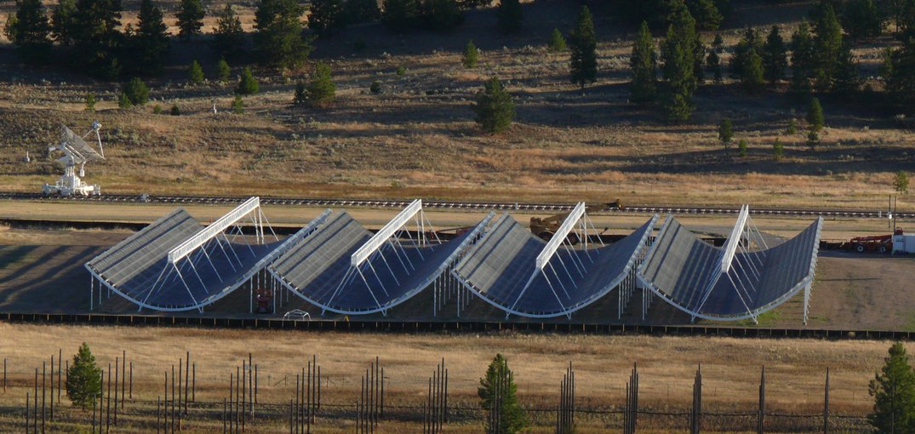
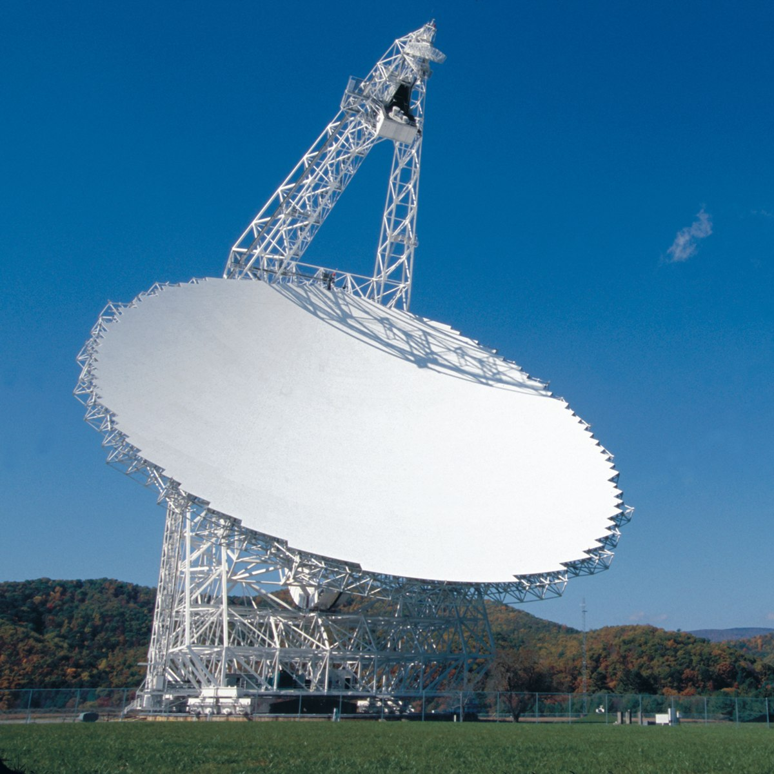
Canadian Hydrogen Mapping Experiment (CHIME)
Introduction/ Motivation:
CHIME is a new project which started taking data in 2018. Its design is unique as it is a drift-scan telescope and therefore is not physically steerable.
However, due to its design it covers a much larger area of the sky. Because of clever optical and signal engineering, they are able to look at multiple locations in the sky at once.
Consequently, the observation rate is much greater than previously used telescopes. As an example, the Arecibo and Greenbank Telescopes only observe specific pulsars once every 3-4 weeks, while CHIME is able to observe them once per day!
These results will lead to much higher precision in the data and will help scientists such as NANOGrav make the first discovery of gravitational waves through pulsar signals.
Radio-Astronomy Basics:
Pulsars are rapidly spinning neutron stars that are the remnants of a massive star that has gone supernova.
FRB sources are unknown! Current theories suggest they come from magnetars, which are similar to pulsars, but have much bigger magnetic fields.
Pulsars are “cosmic clocks”. They spin so accurately that their signal is more reliable than atomic clocks. Their pulse period is extremely stable which makes them useful for experiments.
A current goal is to use pulsars to try and detect gravitational waves. Small irregularities in the pulses over a long time is an indication of gravitational waves given off by a galaxy mergers in the universe.
NANOGrav is currently the North-American group leading the effort using data from the Arecibo and Green Bank telescopes.
100 m
20 m
Fig. 5: 305 m Arecibo Radio Telescope before its recent collapse (12/2020). [Arecibo Observatory]
Fig. 6: Green Bank Telescope, world’s largest fully steerable radio telescope.[NRAO/AUI/NSF]
Fig. 4: Full CHIME telescope with size labeled. [CHIME]
Notes:
I didn’t really understand what you meant by “clever optical”, so I didn’t know how to change it. I bolded it.

Slide 3
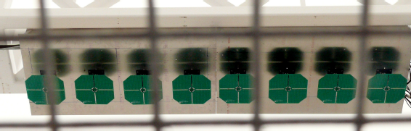
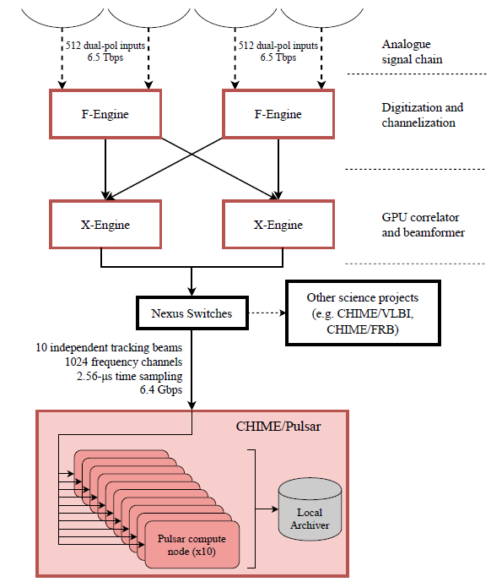
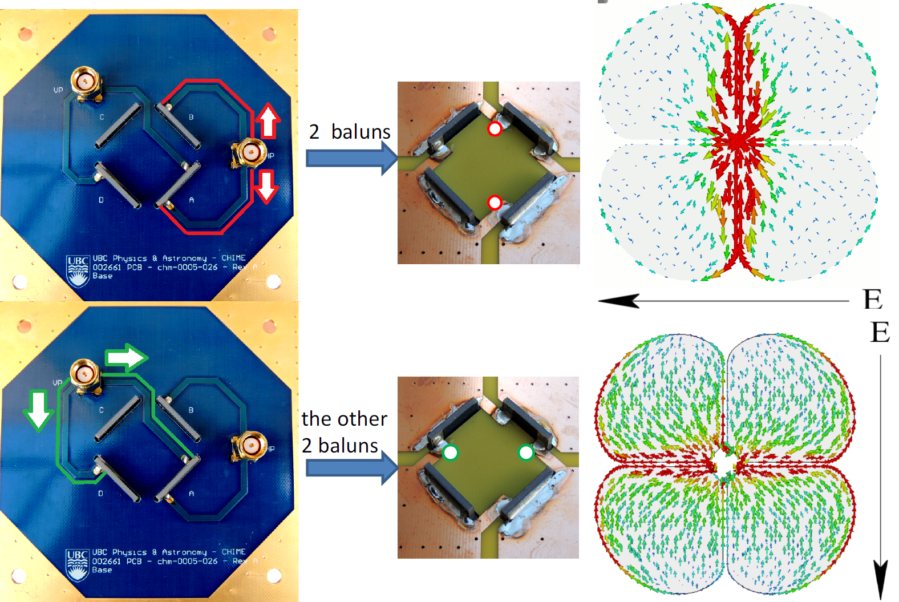
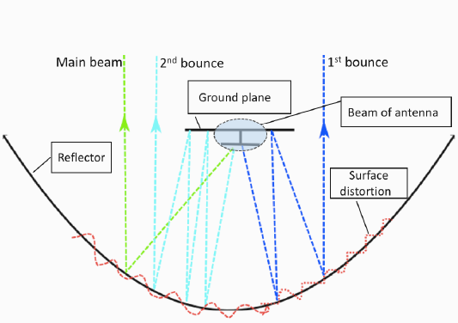
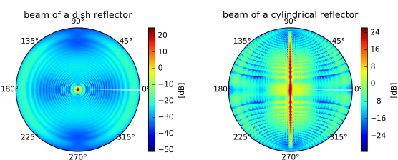
Procedure:
Signals are amplified and brought to a single digital correlator.
Waves combine to create a “beam” that looks at a particular point in the sky.
Data is sent to a science project or archiver.
Canadian Hydrogen Mapping Experiment (CHIME)
Apparatus:
Four 20 m x100 m half cylinders direct incoming radio waves into an array of cloverleaf antennas. f/0.25
Dual-Polarized, meaning that N-S and E-W waves can be detected.
0.3 m
Fig. 7: Linear array of eight cloverleaf antennas installed at the focal line. Note the four slots cut to remove dielectric material from the gaps between the petals. [Deng et al. (2017)]
Fig. 8: (L) Arrangement of the antenna showing and how the capture of both polarizations. (R) Simulated currents for linear polarization at 600 MHz E-W and N-S polarizations shown. [Deng et al. (2017)]
E-W Polarized
Fig. 10: Schematic of the CHIME signal path. Note how the signal is digitalized and channelized before the Beamformer step where the beam is created digitally. [Amiri et al. (2020)]
N-S Polarized
A
Fig. 9: A Diagram of the simulated beam, showing how the waves are combined to create the observing beam. [Deng (2020)]
B Shows the difference between a circular beam from a dish reflector vs. CHIME’s fan-shaped beam. [Deng (2020]
B

Slide 4
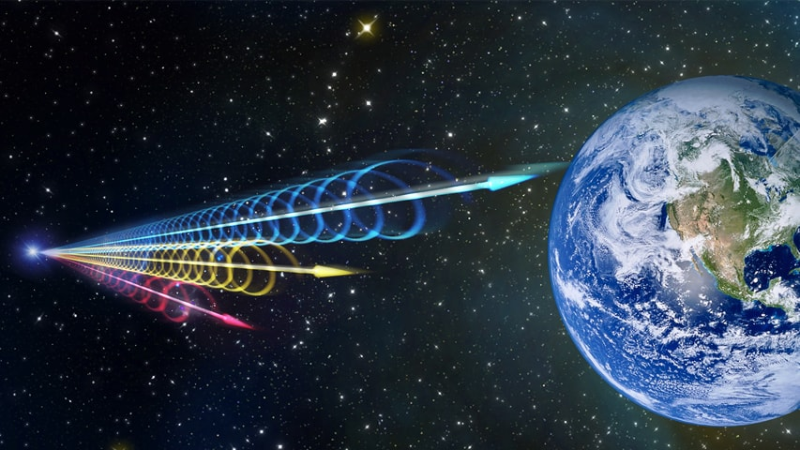
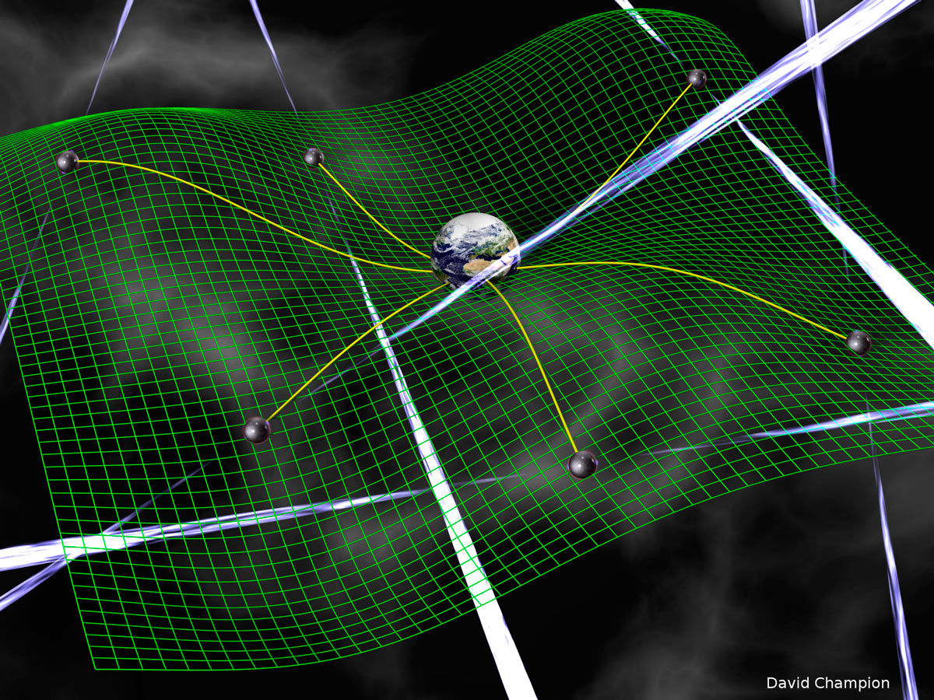
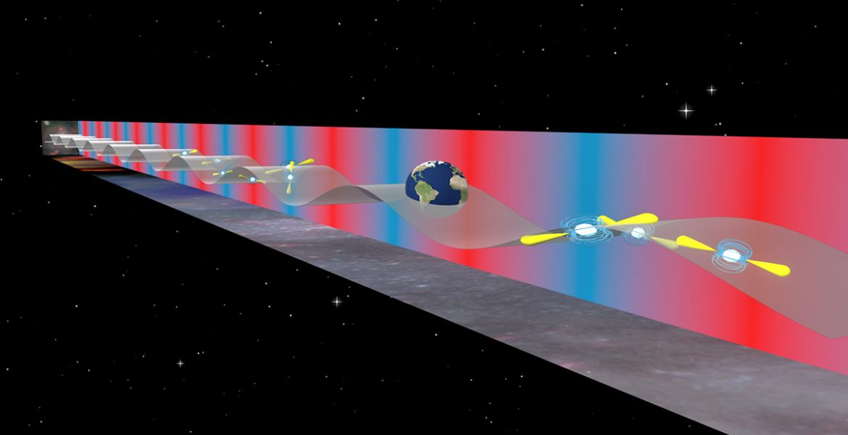
Canadian Hydrogen Mapping Experiment (CHIME)
Results & Discussions:
Over 700 FRBs Detected! These measurements give us information about dispersion measure (a measure of the matter through which the signals travel to reach us), pulse width comparisons between repeaters and non-repeaters, and rotation measures which is a measure of the magnetized environment of a source.
CHIME’s pulsar monitoring system is one of the best in the world. CHIME is capable of observing timing-array pulsars daily, whereas previously, they could only be monitored every 3-4 weeks. These measurements of timing-array pulsars will be crucial in the eventual detection of gravitational waves through pulsar signals.
Conclusions/ Summary:
CHIME is a revolutionary new radio telescope that is a key player in FRB and pulsar astronomy. It is extremely unique and offers capabilities beyond any other telescope in the world. It is only at the beginning of its lifetime, so there is much more to be discovered.
Fig. 12: Visualization of fast radio bursts. [J. Yu, Beijing Planetarium]
Fig. 13: How low-frequency gravitational waves interact with the earth and pulsars. [B. Saxton (NRAO/AUI/NSF)]
Future:
CHIME is a new telescope so there is much more to anticipate. Since the only thing limiting the number of observing beams is computation power, CHIME could augment its number of beams significantly. The results from the FRB side are only becoming better and CHIME will most likely be a key player in discovering FRB sources. With the recent collapse of the Arecibo, CHIME is also looking to become one of NANOGrav’s key telescopes in the detection of gravitational waves.
Fig. 11: Pulsar timing array. Signals from pulsars are delayed if a gravitational waves passes between the earth and the pulsar. We can triangulate a gravitational wave signal coming from galaxy mergers. [D. Champion]

Slide 5
Canadian Hydrogen Mapping Experiment (CHIME)
REFERENCES:
CHIME/Pulsar Collaboration. (2020). The CHIME Pulsar Project: System Overview. Submitted to ApJS.
Clery, D. (2019, March 14). A homespun Canadian telescope could explain mysterious radio signals from the distant universe. American Association for the Advancement of Science, ScienceMag. Retrieved from https://www.sciencemag.org/news/2019/03/homespun-canadian-telescope-could-explain-mysterious-radio-signals-distant-universe
Davis, G. (2012). A Two Element Interferometer Prototype for the Canadian Hydrogen Intensity Mapping Experiment (Doctoral Dissertation, University of British Columbia).
Deng, M., & Campbell-Wilson, D. (2014). The cloverleaf antenna: A compact wide-bandwidth dual-polarization feed for CHIME. 2014 16th International Symposium on Antenna Technology and Applied Electromagnetics (ANTEM), 1-2.
Deng, M. (2020). Antenna Array Design, Beam Calibration of the CHIME to Measure the Late-time Cosmic Acceleration and Mapping of the North Celestial Cap (Doctoral Dissertation, University of British Columbia).
Falk, D. (2015, April 1). Canada chimes in. Reach Magazine.
Ferrara, E. (2016, April 5). Gravitational Wave Search Provides Insights into Galaxy Evolution and Mergers. The National Radio Astronomy Observatory. Retrieved from https://public.nrao.edu/news/2016-nanograv-sbr/
Kohler, S. (2020, March 13). CHIME Detects Even More Repeating Bursts. American Astronomical Society Nova. Retrieved from https://aasnova.org/2020/03/13/chime-detects-even-more-repeating-bursts/
Leung, M. (2008). A Wideband Feed for a Cylindrical Radio Telescope (Doctoral Dissertation, University of Sydney).

